Slide 1

jQuery
Ranken Technical College

Slide 2
Objectives
jQuery Download vs. CDN
Basic jQuery Selectors
jQuery Getters and Setters
Event Handling with jQuery
Adding and Removing classes dynamically with jQuery

Slide 3
Installing jQuery
Downloading jQuery or hosting it on a CDN.

Slide 4
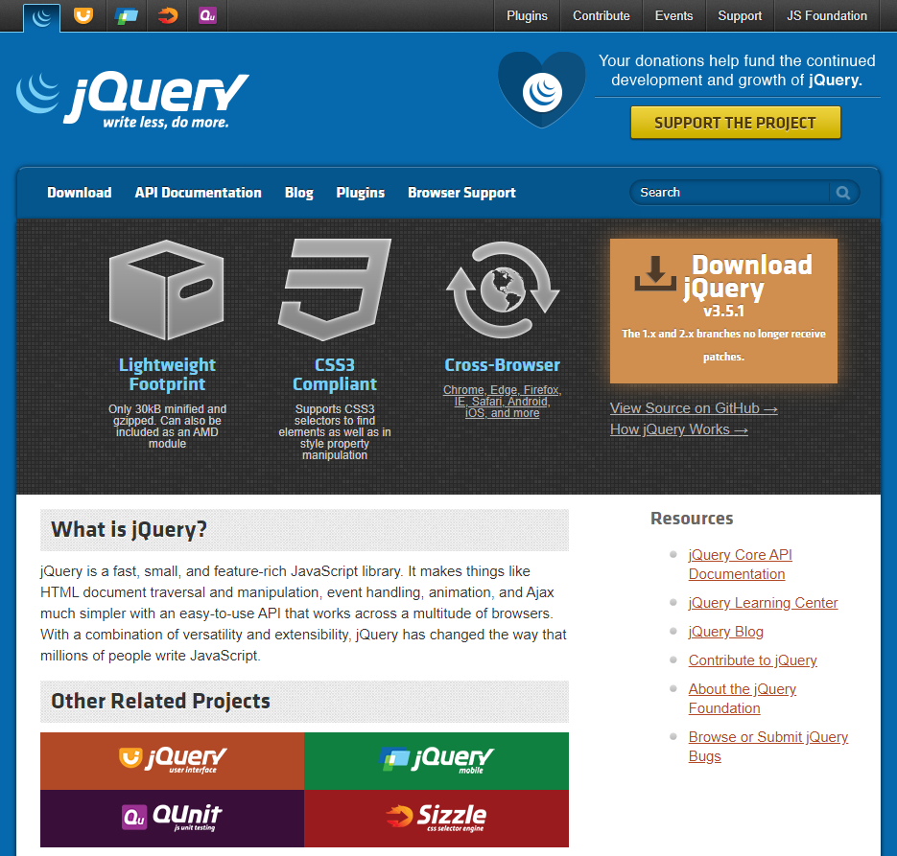
jQuery Website
The jQuery website (https://jquery.com/) provides comprehensive documentation of the entire jQuery library and many helpful articles to get you started.
Notes:
https://jquery.com/

Slide 5
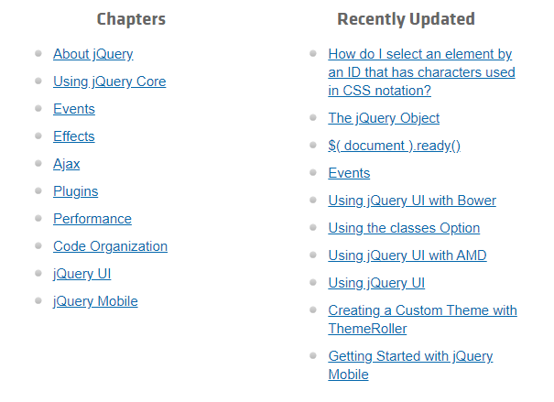
jQuery Learning Center
You can find several helpful tutorials in the jQuery Learning Center (https://learn.jquery.com/)
Notes:
https://jquery.com/

Slide 6
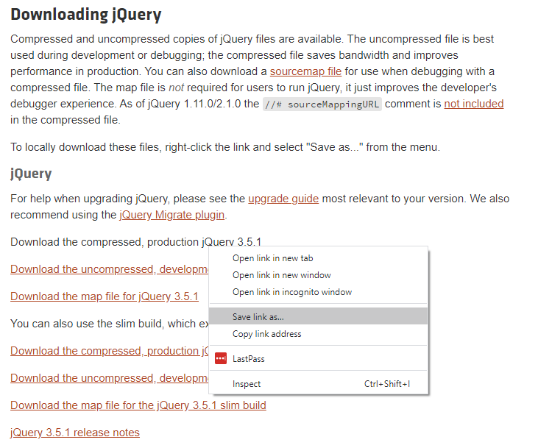
Downloading jQuery
You can download jQuery directly from
the Download page.
Do this in Chrome by right-clicking the link and selecting Save link as…
Make sure to dowload the compressed production version.

Slide 7
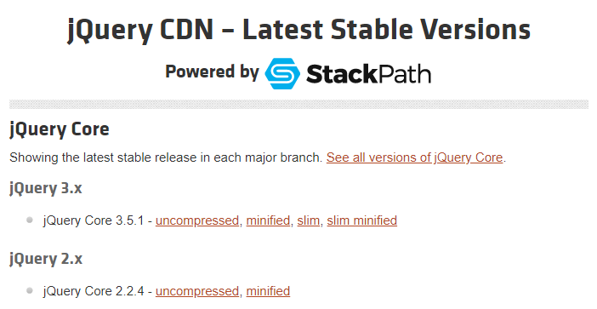
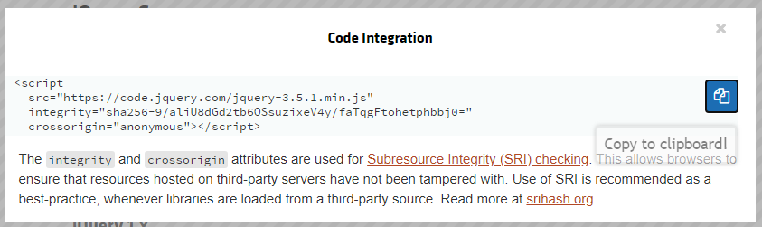
jQuery via CDN
Or you can use jQuery via a CDN.
Get the script tag here
https://code.jquery.com/
Make sure to get the minified version.
Also make sure that the protocol is https.
For security, be sure to include the integrity and crossorigin properties as shown.

Slide 8
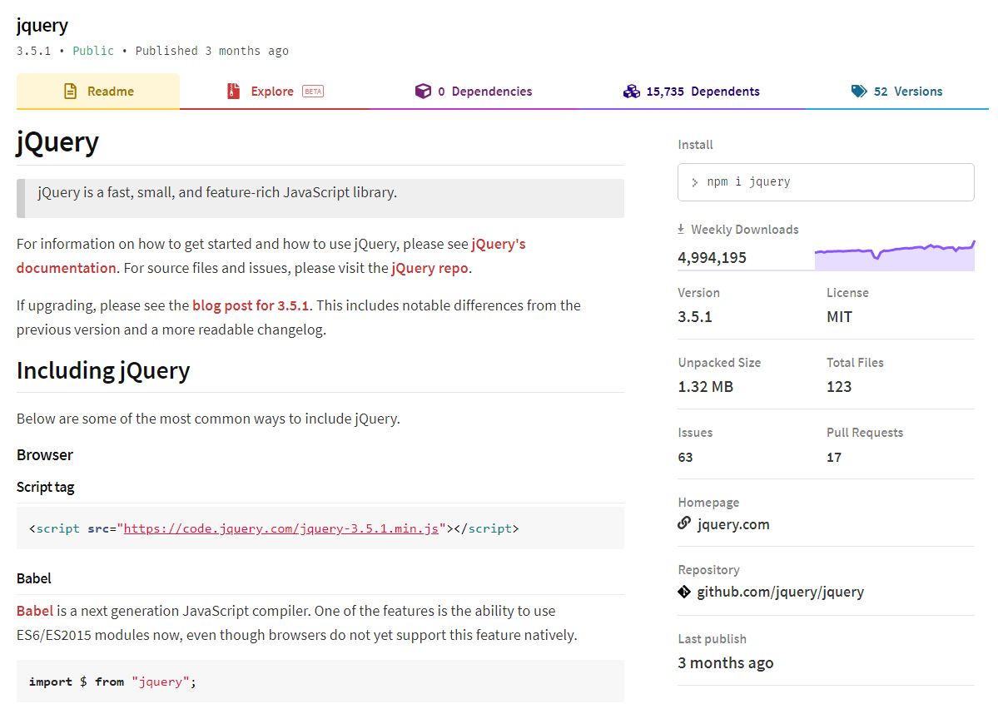
jQuery via npm
You can also download jQuery as an npm package, which we will discuss later in the course.
https://www.npmjs.com/package/jquery

Slide 9
CDNs
Hosting front-end libraries with a CDN. Why or why not?

Slide 10
What is a CDN?
A Content Delivery Network (CDN) is a geographically distributed network of servers designed to deliver static content.
A CDN can cache content for your website including HTML pages, CSS stylesheets, JavaScript files, images, and videos.
When the user loads a webpage, they generally receive these files from a server that is geographically closest to them,
Using a CDN means that you do not have to physically download the files onto your system, you simply let the browser download them as needed.
However, you must have stable internet access to use a CDN.
Notes:
https://www.colocationamerica.com/blog/cdn-advantages-and-disadvantages

Slide 11
CDN Advantages
Decreased Server Load
The content is spread out across several servers, reducing the load on all servers.
This increases the number of concurrent users that your application can handle.
Faster Content Delivery
The servers in a CDN network are generally more powerful than your application server.
The CDN servers only need to serve static content, they do not need to execute application logic or interface with the database.
They often cache the files they serve in memory, instead of needing to read them from the file system.
High probability that a visitor has already downloaded the library from a CDN, and therefore the file won't need to be downloaded again.
Notes:
https://www.bluepiit.com/blog/6-advantages-of-using-a-content-delivery-network-cdn/
https://www.colocationamerica.com/blog/cdn-advantages-and-disadvantages

Slide 12
CDN Advantages
Higher Availability
CDNs can dynamically fallback to another server, whenever a server goes offline or must be taken down for maintenance.
Thus CDNs can offer 100% availability, even with large power, network, or hardware outages.
Security
By dynamically distributing content among multiple servers, it can make it much harder to attack the server with Distrubuted Denial of Service (DDoS) attacks.
Notes:
https://www.bluepiit.com/blog/6-advantages-of-using-a-content-delivery-network-cdn/
https://www.colocationamerica.com/blog/cdn-advantages-and-disadvantages

Slide 13
CDN Disadvantages
Internet Access Needed
In order to access content from a CDN your user must have stable internet access.
They don’t just need to access to your application, they also need access to the broader internet.
This can sometimes be a problem with mobile, developing contries, and users that travel frequently.
This is a major blocker for intranet and government applications.
Additional Risks
CDNs can fail too. It's much less likely than your own servers failing, but it still happens occasionaly. (Cloudflare DNS goes down, taking a large piece of the internet with it.)
The speed and availability of CDN servers can be affected by all users of the CDN, so increased traffic to other websites may slow down pages on your website.
Sometimes the download speed from the CDN server can be slower than from your own server.
Notes:
https://www.colocationamerica.com/blog/cdn-advantages-and-disadvantages
https://techcrunch.com/2020/07/17/cloudflare-dns-goes-down-taking-a-large-piece-of-the-internet-with-it/

Slide 14
Selectors
Selecting the DOM elements with jQuery.

Slide 15
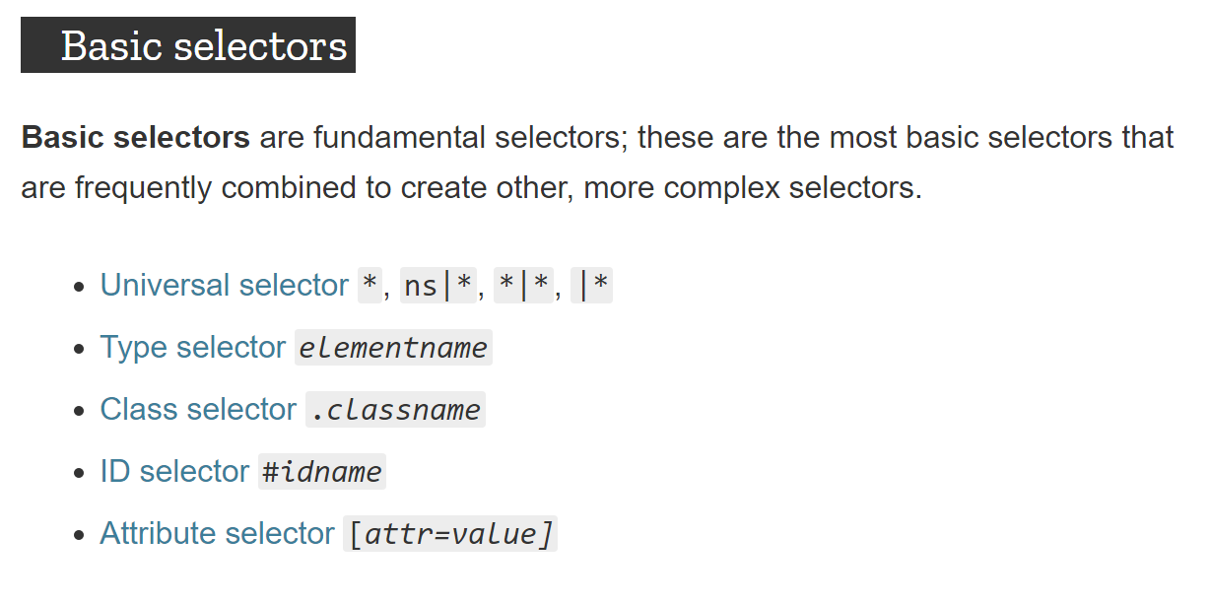
https://developer.mozilla.org/en-US/docs/Web/CSS/Reference#Basic_selectors
Notes:
https://developer.mozilla.org/en-US/docs/Web/CSS/Reference#Basic_selectors

Slide 16
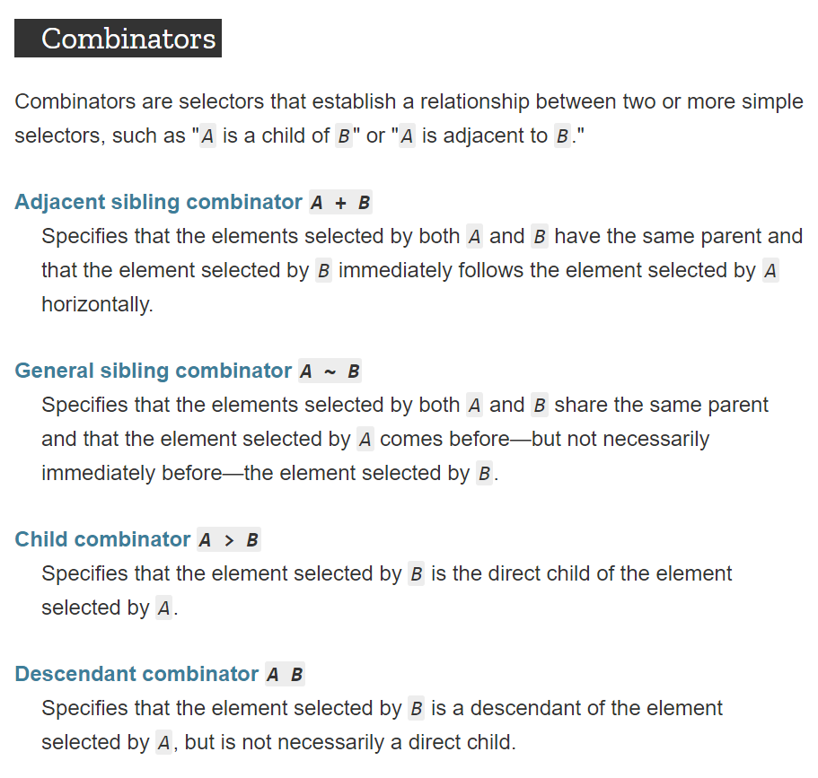
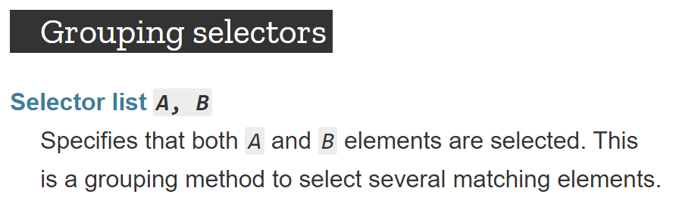
https://developer.mozilla.org/en-US/docs/Web/CSS/Reference#Basic_selectors
Notes:
https://developer.mozilla.org/en-US/docs/Web/CSS/Reference#Basic_selectors

Slide 17
ID Selector
We can use the ID selector to select DOM elements based on their ID.
Example HTML
<input id="fahrenheit" class="form-control" type="number" />
<input id="celsius" class="form-control" type="number" />
Example JavaScript
$('#fahrenheit').val(212);
$('#celsius').val(100);
Notes:
https://www.colocationamerica.com/blog/cdn-advantages-and-disadvantages
https://techcrunch.com/2020/07/17/cloudflare-dns-goes-down-taking-a-large-piece-of-the-internet-with-it/

Slide 18
Class Selector
We can use the class selector to select DOM elements based on their class.
Example HTML
<input id="fahrenheit" class="form-control" type="number" />
<input id="celsius" class="form-control" type="number" />
Example JavaScript
$('.form-control').val('');
Notes:
https://www.colocationamerica.com/blog/cdn-advantages-and-disadvantages
https://techcrunch.com/2020/07/17/cloudflare-dns-goes-down-taking-a-large-piece-of-the-internet-with-it/

Slide 19
jQuery Selectors
"Borrowing from CSS 1–3, and then adding its own, jQuery offers a powerful set of tools for matching a set of elements in a document."
You can view the full list of selectors that jQuery provides in the documentation.
https://api.jquery.com/category/selectors/
Notes:
https://api.jquery.com/category/selectors/

Slide 20
Getters & Setters
Accessing DOM properties and attributes with jQuery.

Slide 21
Getters & Setters
The methods listed below can be used as either getters or setters.
Method | Example Getter | Example Setter
.val() The current value of the element | $('#celsius').val() | $('#celsius').val(100)
.html() The HTML contents of the element | $('#result').html() | $('#result').html('<h2>Done!</h2>')
.prop() Value of a property | $('#check').prop('checked') | $('#check').prop('checked', true)
.attr() Value of an attribute | $('#image').attr('src') | $('#image').attr('src', 'cat.jpg')
.css() Value of a css property | $('#result').attr('color') | $('#result').attr('color', '#ff0000')

Slide 22
Classes
The methods listed below can be used manipulate the classes applied to elements.
Method | Example
.hasClass() Determine whether any of the matched elements have a particular class | $('#result').hasClass('text-danger')
.addClass() Adds class to each element in the set of matched elements. | $('#result').addClass('text-danger')
.removeClass() Remove class from each element in the set of matched elements. | $('#result').removeClass('text-danger')
.toggleClass() Add or remove class from each element in the set of matched elements, depending on the class’s presence. | $('#result').toggleClass('text-danger')

Slide 23
Chaining
You can chain multiple methods to set multiple values at once.
Examples
$('#image').attr('src', 'cat.jpg').attr('alt', 'My Fluffy Cat');
$('#result').addClass('text-danger p-3').html('<h2>Something went wrong!</h2>');

Slide 24
Events
Responding to events with jQuery.

Slide 25
.change()
The .change() method can be used add an event handler for the JavaScript "change" event.
For text inputs and text areas, this event fires when the control loses focus.
For radio buttons and checkboxes, the event fires when the control is clicked.
For <select> dropdowns, the event fires when the user makes a new selection.
Example
$('#celsius').change((evt) => {
// Respond to event
});
Sources
https://api.jquery.com/change/
https://developer.mozilla.org/en-US/docs/Web/API/HTMLElement/change_event

Slide 26
.click()
The .click() method can be used add an event handler for the JavaScript "click" event.
Event fires when the element is clicked with a mouse or tapped with a touch screen.
Example
$('#celsius').click((evt) => {
// Respond to event
});
Sources
https://api.jquery.com/click/
https://developer.mozilla.org/en-US/docs/Web/API/Element/click_event

Slide 27
.keydown()
The .keydown() method can be used add an event handler for the JavaScript "keydown" event.
Event fires when a key is pressed on a hardware or software keyboard.
Example
$('#celsius').keydown((evt) => {
// Respond to event
});
Sources
https://api.jquery.com/keydown/
https://developer.mozilla.org/en-US/docs/Web/API/Element/keydown_event

Slide 28
.focus()
The .focus() method can be used add an event handler for the JavaScript "focus" event.
Event fires when an element gains focus.
Example
$('#celsius').focus((evt) => {
// Respond to event
});
Sources
https://api.jquery.com/focus/
https://developer.mozilla.org/en-US/docs/Web/API/Element/focus_event

Slide 29
.blur()
The .blur() method can be used add an event handler for the JavaScript "blur" event.
Event fires when an element loses focus.
Example
$('#celsius').blur((evt) => {
// Respond to event
});
Sources
https://api.jquery.com/blur/
https://developer.mozilla.org/en-US/docs/Web/API/Element/blur_event

Slide 30
.submit()
The .submit() method can be used add an event handler for the JavaScript "submit" event.
Event fires when a <form> is submitted.
Example
$('#form').submit((evt) => {
// Respond to event
});
Sources
https://api.jquery.com/submit/
https://developer.mozilla.org/en-US/docs/Web/API/HTMLFormElement/submit_event

Slide 31
.on('reset', handler)
The .on() method can be used add an event handler for the JavaScript "reset" event.
Event fires when a <form> is reset.
There is not shorthand for the "reset" event.
Example
$('#form').on('reset', (evt) => {
// Respond to event
});
Sources
https://api.jquery.com/on/
https://developer.mozilla.org/en-US/docs/Web/API/HTMLFormElement/reset_event

Slide 32
Other Events
The .on() method can be used to register an event handler.
The .trigger() method can be used to fire an event.
Example
$('#form').on('reset', (evt) => {
// Respond to event
});
// Fire event
$('#form').trigger('reset');
Sources
https://api.jquery.com/on/
https://api.jquery.com/trigger/

Slide 33
.preventDefault()
Often we need to prevent the default action associated with an event.
For links, this would be navigating/scrolling to the apropriate resource.
For the form submit event, this would be submitting the form and navigating to another page.
For the form reset event, this would be reseting all input fields back to their original values.
Example
$('#form').on('submit', (evt) => {
evt.preventDefault();
});
Sources
https://api.jquery.com/event.preventDefault/

Slide 34
.stopPropagation()
Sometimes we need to halt an event from being processed by other event handlers.
Example
$('#form').on('submit', (evt) => {
evt.preventDefault();
evt.stopPropagation();
});
Sources
https://api.jquery.com/event.stopPropagation/

Slide 35
Example
$('#calc-tax-form').submit((evt) => {
evt.preventDefault();
const price = parseFloat($('#price').val());
const tax = parseFloat($('#tax').val());
if (price && tax) {
const total = Math.ceil(price * (1 + tax / 100));
$('#result').html(`Your total is ${total.toFixed(2)} USD.`);
} else {
$('#result').html('Please enter a price and tax percentage.');
}
});

Slide 36
Conclusion
What did we learn today?

Slide 37
What We Covered
jQuery Download vs. CDN
Basic jQuery Selectors
jQuery Getters and Setters
Event Handling with jQuery
Adding and Removing classes dynamically with jQuery

Slide 38
Some Useful URLs
jQuery Website
jQuery API Docs
jQuery Learn: Handling Events

